Slide 1

Characteristics of Technical Communication
Week 2

Slide 2
Overview
Sentences and Paragraph (Common Errors)
01
Organization
03
Clarity, Conciseness
02

Slide 3
Common Clarity Errors
Clarity is crucial to effective technical communication
Diverse Audience Groups (Background, knowledge of subject matter)
Correspondence over a Period of Time: Time Gap can have led to information loss
Providing Specific, clear details

Slide 4
Providing Specific Details
Specific, quantified information (use of quantifiers)
Avoid use of vague adjectives like some and adverbs like really
Measurements, Dates, Monetary amounts etcetra

Slide 5
Reporter’s Questions
Who, What, Where, When, Why
Make sure the subject/action is clear
Who is responsible for the action involved?
Timelines/Deadlines if any

Slide 6
Reporter’s Questions
Plan these details beforehand for clarity
Write/Frame them clearly

Slide 7
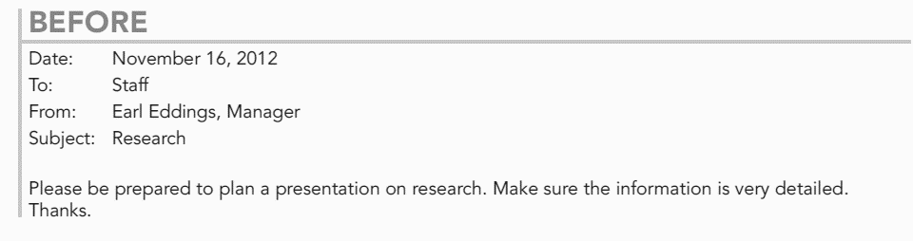
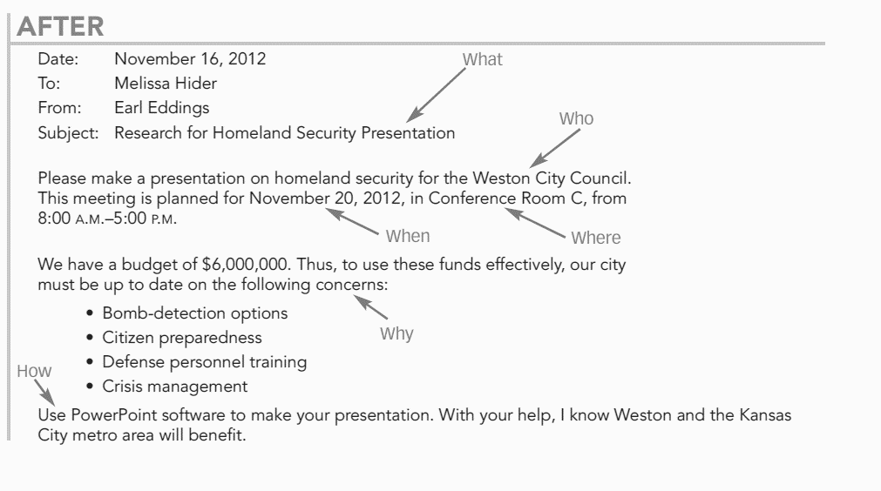

Slide 8
Use Easily Understandable Words
Avoiding unfamiliar jargon
Avoiding Obscure Words
Express don’t impress
Avoid uncommon terms to ensure understanding
Avoid jargon: If used, provide glossary

Slide 9
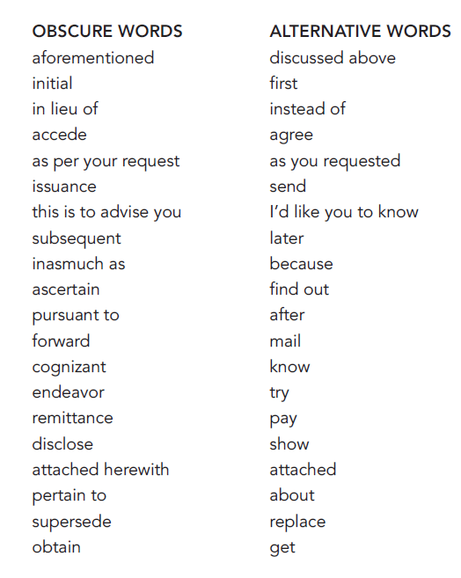

Slide 10
Use active voice
Avoid helping verbs (forms of verb to “be”: is, am, are, was, were, being, been)
Can cause wordiness and lack of clarity
Exception: Properly used when showing a situation that is typical or to avoid an accusation

Slide 11
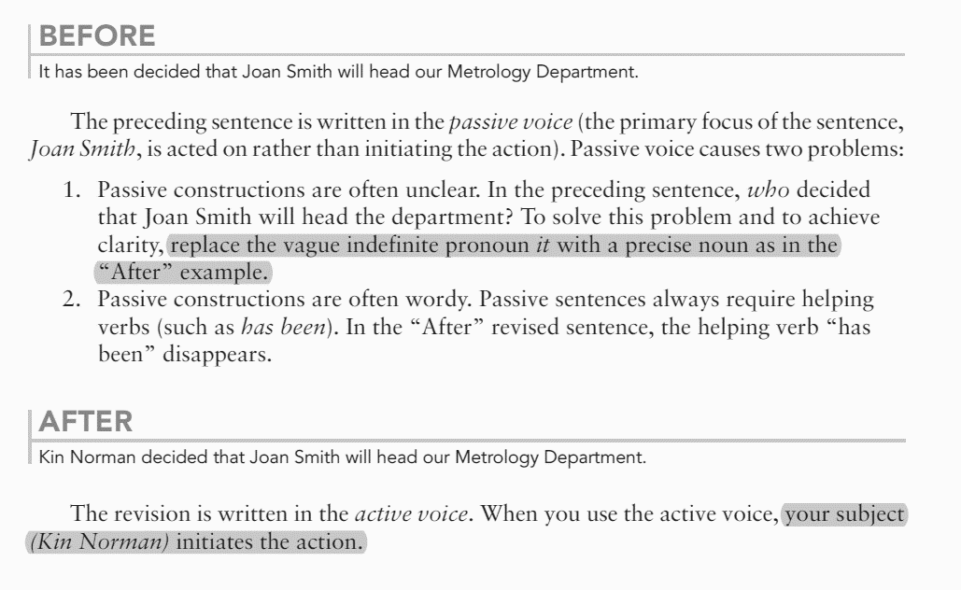
Example

Slide 12
Avoid Prepositional Phrases
Limit their use
Used for information about time and place
Prepositional phrases = preposition + noun/pronoun

Slide 13
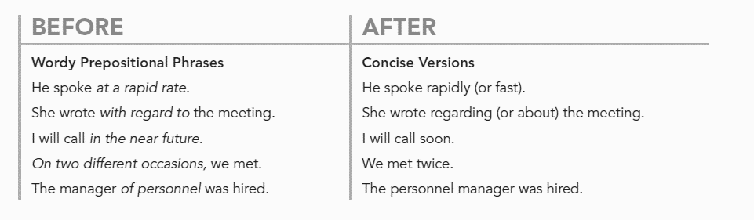

Slide 14
Put the Main Idea First
To put the main idea first (at the “top”) is a key principle for writing sentences that are easy to understand.
Place the sentence’s main idea—its subject—first.
Readers relate subjects to their own ideas and experiences and thus orient themselves.

Slide 16

Avoid Expletive Pattern
Avoid sentences beginning with There and It

Slide 17
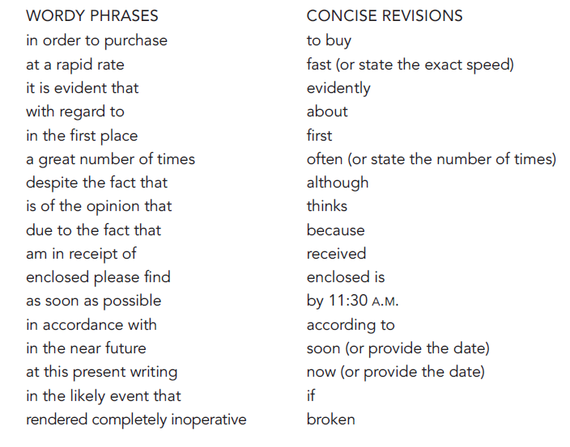

Slide 18
Avoid Nominalizations
Nominalizations weaken sentences by making action as a static noun instead of an active verb
Avoid Verbs turned into Nouns by adding a suffix such as –ion –ity –ment –ness
installation
Completion
imposition

Slide 19
Use of Parallelism
Similar structure for similar elements
Parallel structure indicates to the reader that the ideas are equal in value (coordinate)
Words in a series should have the same structure

Slide 21
Simplifying Words, Sentences and Paragraphs for Conciseness
Conciseness saves time
Conciseness aids clarity
Technology Demands Conciseness

Slide 22
Simplifying Words, Sentences and Paragraphs for Conciseness
More detail- less words
People don’t have time to engage in lengthy communication
Emails: 20-40 lines of text
Technology provides limited space (screen size, format), character limitations (IMs, messaging, Twitter), Resumes, Emails
Resume: 55 lines and 70-80 characters per line
More detail- less words

Slide 23
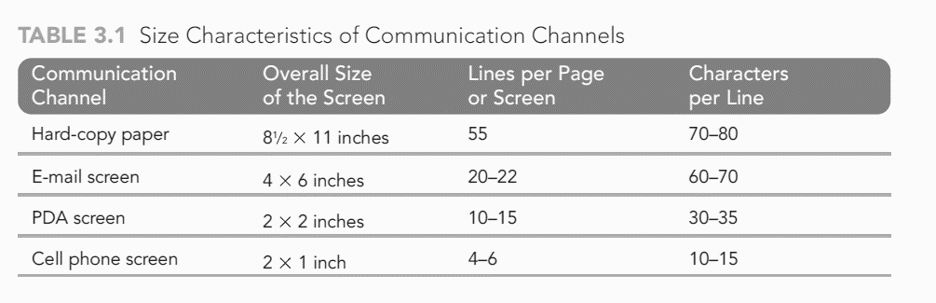

Slide 24
Limit Paragraph Length
Not more than 50 words in a paragraph

Slide 25
Limit Sentence Length
Average sentence is 15-20 words
Easy to Read: 12 words per sentence
Sentences having more than 20 words are difficult

Slide 26
Revision
Meat Clever Method
Avoid Shun Words
Cut sentences into one halves or one thirds
Makes it easier to understand and improves conciseness
Avoid words ending in –tion or –sion
Words ending in shun sound
Unnecessarily wordy

Slide 27
Conciseness Improves Readability
Readability = reading level of a document
Linear Write Index
Gauge your readability level
Lazy Word Index
It is determined by length of sentence and the length of words used (more than 3 syllables)
Flesch Reading Ease Index
Level of audience: Who are you writing for?
Gunning’s Fox Index

Slide 28
FOG INDEX CALCULATOR
*Exceptions are proper names, long words that are created by combining shorter words, words created by –ed or –es
Multisyllabic words like jargon are unavoidable.
Step 1: Count upto 100 words and then, divide number of words/number of sentences.
Count long words within a sentence (3 or >3 syllables)*.
Fog Index = "No. of words per sentence + No. of long words" x 0.4

Slide 29
Activity
http://gunning-fog-index.com/
Use the paragraph provided yesterday in your worksheet into the text box on this site and check its fog index.
Copy the paragraph you rewrote into the text box on this site and check its fog index.

Slide 30
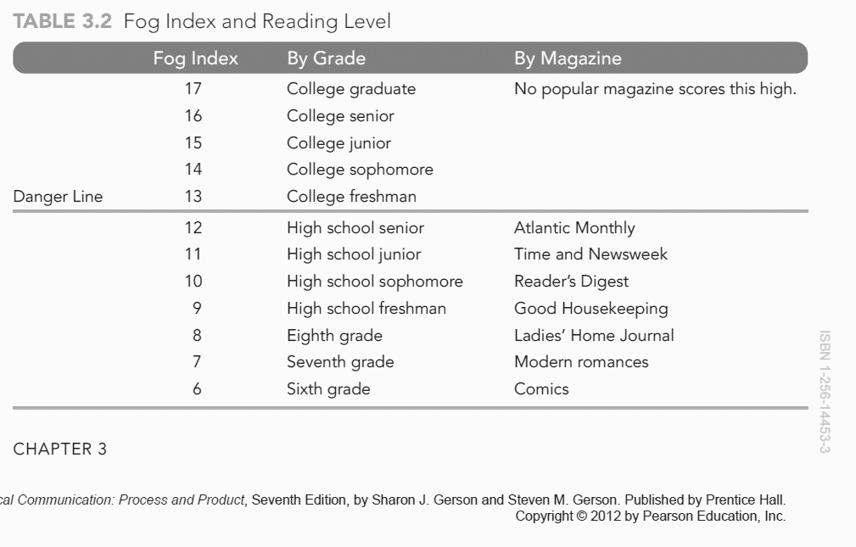

Slide 31
Avoiding Sexist Language
Language is sexist when the word choice suggest only one sex when both are intended
The clerk must make sure that he punches in
The clerk must make sure to punch in
The clerk must make sure that they punch in
Everyone will bring their special dish to the company potluck.
Use an infinitive
Use a plural
Use the plural to refer to plural sense singulars

Slide 32
Achieving Accuracy in Technical Communication
Misleads audience
Avoiding being Incorrect-grammatically or contextually
Destroys authorial credibility

Slide 33
Spot the Errors

Slide 34
Proofreading Tips
Another set of eyes helps
Come back to your draft after some time
Read backwards
Read one line at a time
Read long word syllables one by one
Use technology
Check figures, scientific and technical equations and abbreviations
Read it out loud
Try scattershot proofing
Use a dictionary

Slide 35
Organizing Technical Communication
Five Patterns of Organization
Spatial
Chronological
Importance
Comparison/Contrast
Problem/Solution

Slide 36
Spatial
Used for technical specification to describe parts of a machine or a plot of ground
Left to right
Clockwise
Inside to outside
Top to Bottom
Direction (North, South, East or West)
The purpose of spatial organization pattern is:
Visualization
understanding physical qualities of the subject matter

Slide 38
Chronological
Chronology is used to document time, steps in a process analysis, or the steps in an instruction
Chronology is used to document the steps in an instruction

Slide 39
Example

Slide 40
Importance
Placing the information on the basis of importance
One third from the top of the page
Two thirds from the bottom (eye level)
NOTE that this applies to bullet list of points as well
Sequence them in order of importance

Slide 42
Comparison/Contrast
Organizing text by comparison/contrast is achieved by comparing similarities and differences

Slide 43
Problem/Solution
To clarify the value of product or service, you should emphasize the reader’s need
Proposals
Problem/Solution organization clarifies the intent
Sales letter

Slide 44
Example

Slide 45
Ethics of Technical Communication
Ethical communication is an honest expression of ideas about any product or service and considers the needs of both the customer and the business.
Legal
Practical
Ethical
Focusing on liability, negligence and consumer protection laws
Dishonest technical communication backfires and can cause company to lose sales and suffer legal expenses
Written to promote customer welfare and avoiding deceiving the end user

Slide 46
Legalities
Trust your instincts and laws
Laws are written to protect customers, company and employee
When in doubt about the community impact, seek legal counsel

Slide 47
Practicalities
As a technical communicator, your goal is candor (truthful, State the facts)
“Good ethics is good business”

Slide 48
Ethicalities
Use language and visuals with precision
Prefer simple, direct expression of ideas
Respect the work of colleagues, knowing that a communication problem may have more than one solution
Strive continually to improve my professional competence
Satisfy the audience’s need for information, not my own need for self-expression
Hold myself responsible for how well my audience understands my message
Promote a climate that encourages the exercise of professional judgment and that attracts talented individuals to careers in technical communication

Slide 49
Ethicalities
Legality
Honesty
Confidentiality
Quality
Fairness
Professionalism

Slide 50
Sources
Technical Communication: Process and Product (7th ed.) Chapter 2

